Slide 1

Namma Yatri.xlxs

Slide 2
Problem Statement
The ride-hailing industry faces challenges like high trip cancellations, demand-supply mismatches, fare fluctuations, and low digital payment adoption. This analysis aims to develop Power BI dashboards to optimize operations and enhance customer experience.
Objective
Analyze ride-hailing patterns to identify key inefficiencies.
Optimize fare pricing strategies using data insights.
Improve driver allocation based on demand-supply trends.
Increase digital payment adoption among customers.

Slide 3
Approach Used
Data Cleaning & Transformation
Data Modeling in Power BI
DAX Measures for KPIs
Dashboard Creation & Insights Extraction
Business Recommendations
Methadology
Data Cleaning & Transformation in Power Query.
Data Modeling & Relationship Setup in Power BI.
DAX Measures for KPI Calculations.
Development & Insights Generation.
Business Recommendations & Implementation.

Slide 4
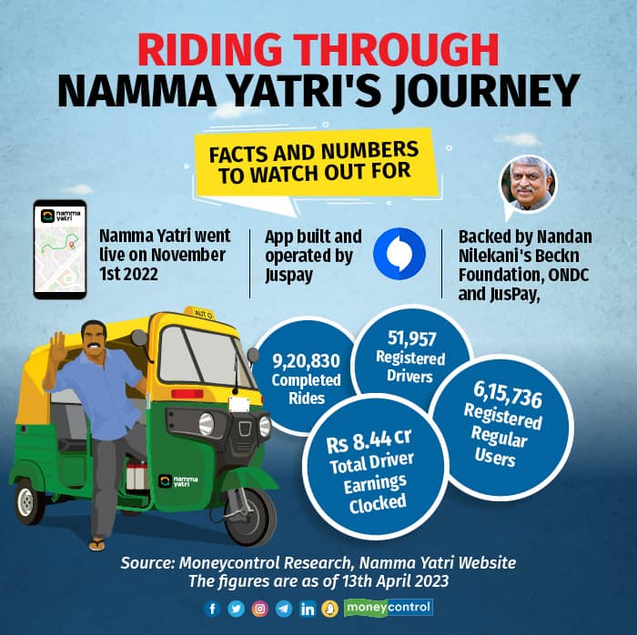
Data Source
Dataset includes:
Trips (Trip ID, Fare, Duration, Distance, Driver ID, Customer ID)
Trip Details (Customer interactions, Cancellations, Completions)
Payment Methods (Cash, UPI, Debit Card)
Assembly Locations (Pickup & Drop Zones)

Slide 5
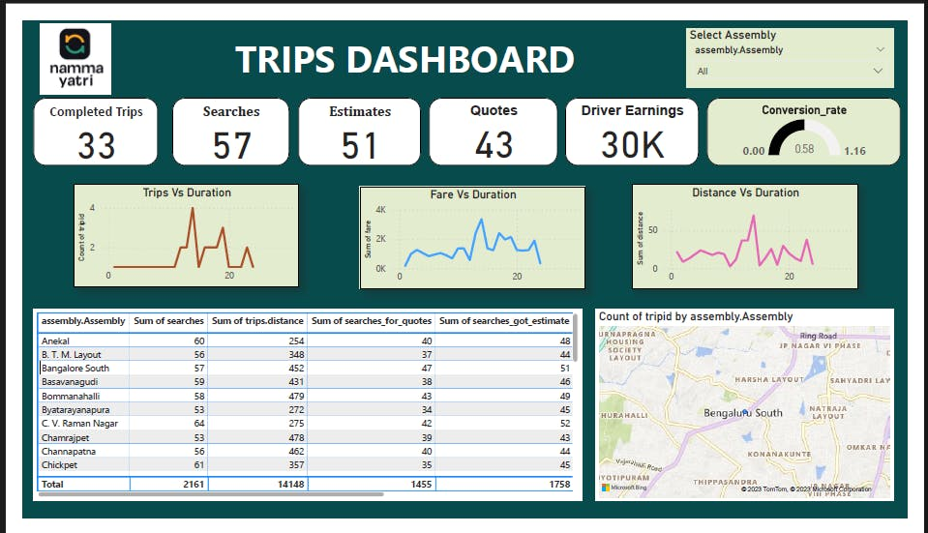
Key DAX Measures
Total Trips = COUNT(Trips[tripid])
Total Revenue = SUM(Trips[fare])
Average Fare = AVERAGE(Fare)
Top Pickup Locations = COUNT(Trips[loc_from])

Slide 6
Editing & Modifications
Removed Duplicates & Handled Missing Values
Created Time-Based Aggregations (Peak Hours, Distance Categories)
Established Relationships Between Tables
Optimized Queries for Performance in Power BI

Slide 7

Business Insights
High drop-off rates during fare estimates → Implement Predictive Pricing
Demand-Supply gaps in key areas → Improve Driver Allocation
Fare spikes during peak hours → Optimize Dynamic Pricing
UPI Adoption growing, but cash still dominates → Offer Digital Payment Incentives

Slide 8
Expected Outcomes
Enhanced demand-supply matching to reduce wait times.
AI-driven fare optimization to balance affordability & revenue.
Increased digital payment adoption through targeted incentives.
Improved driver performance through better data-driven allocation.

Slide 9

Conclusion
Data-driven insights help optimize ride-hailing operations.
Reducing cancellations & improving pricing can boost customer retention.
Smart allocation of drivers increases efficiency & service quality.
Digital transformation strategies will enhance financial performance.

